Slide 1
CILT- Gatwick Group
Sharon Hedges
16th April 2019

Slide 2
About Transport Focus
Transport Focus is the independent consumer watchdog
We represent the interests of:
Rail passengers in Great Britain
Bus, coach and tram users across England outside London
All users of England’s motorways and major ‘A’ roads (the Strategic Road Network)
We aim to be useful and to make a difference
Robust evidence-based research and policy – we publish all our work
Present users’ priorities and experiences … pro consumer

Slide 3
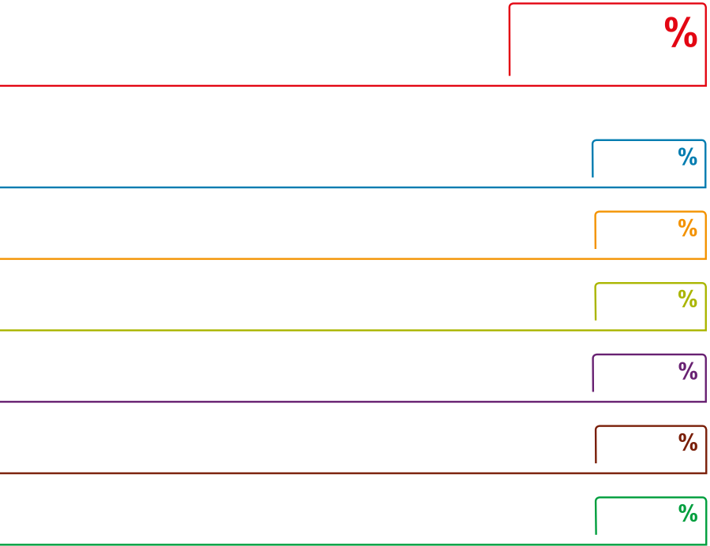
[Headline]
Bus Passenger Survey
Headline results for Metrobus in 2018
Overall
journey
Journey time
Punctuality
Value for money
fare-payers only
Bus driver
greeting/welcome
Interior cleanliness
and condition
Availability of seating
or space to stand
Figures shown are total very or fairly satisfied.
Last year's figure shown in grey, where available.

Slide 4
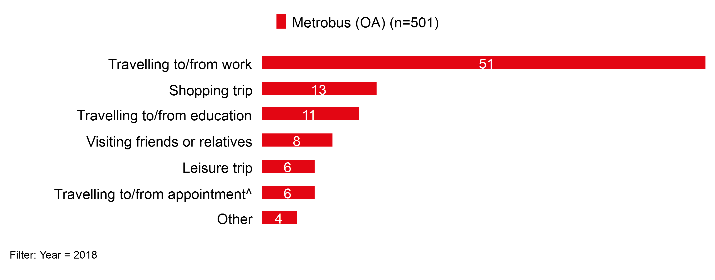
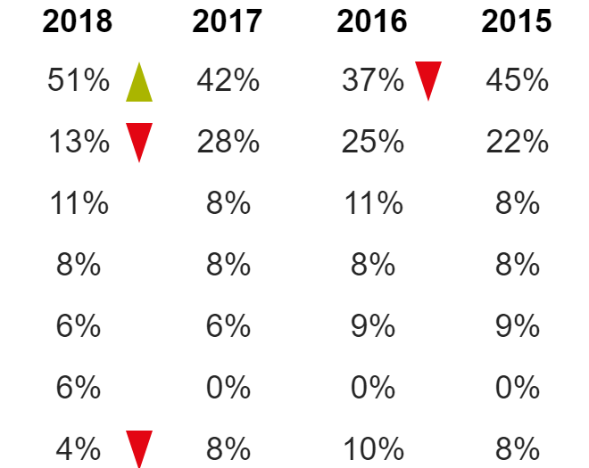
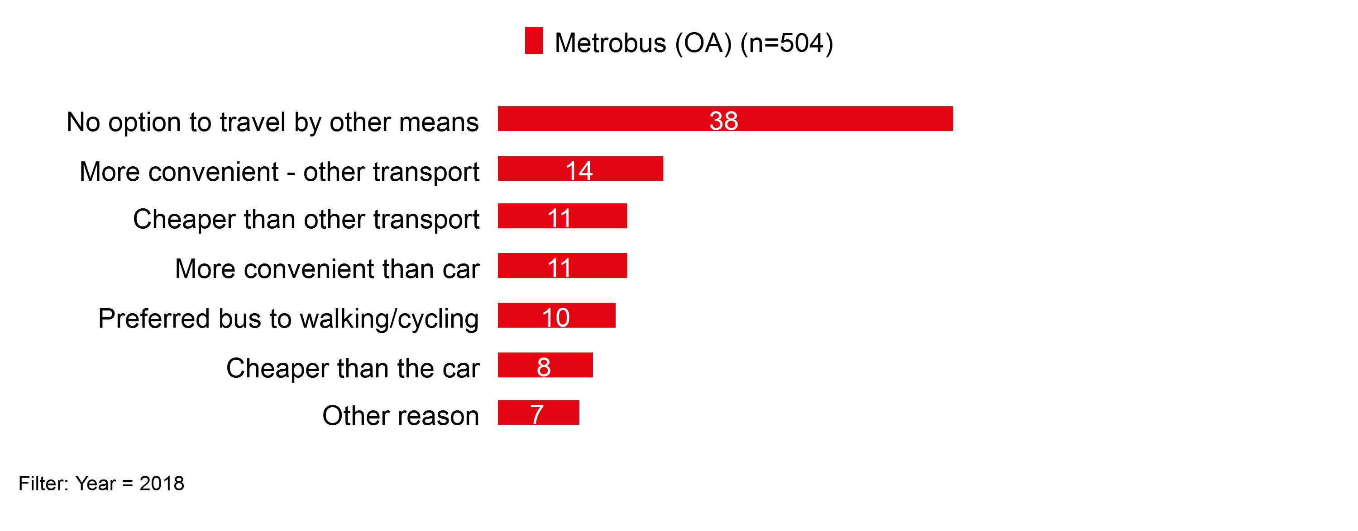
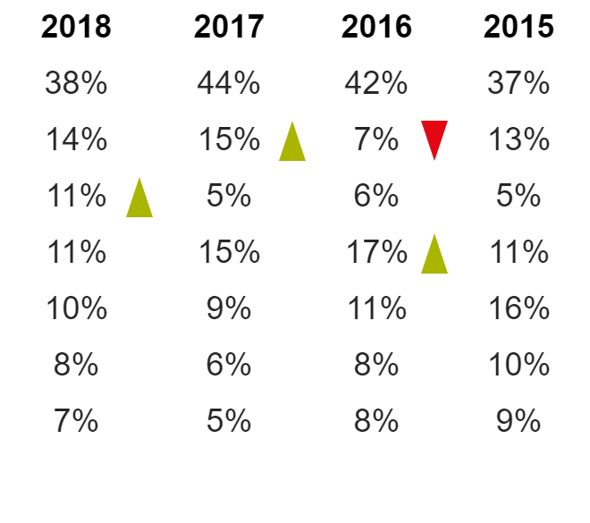
[Headline]
Heading out: journey purpose and reason for choosing bus
Journey purpose
Metrobus
Trend figures and Go-Ahead overall figs
Reason for choosing to take the bus
Q. What is the main purpose of your bus journey today? Items marked ^ were new in 2018
Q. What was the main reason you chose to take the bus for your journey today?

Slide 5
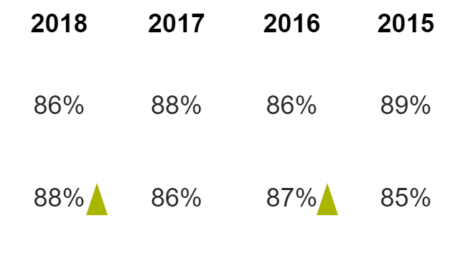
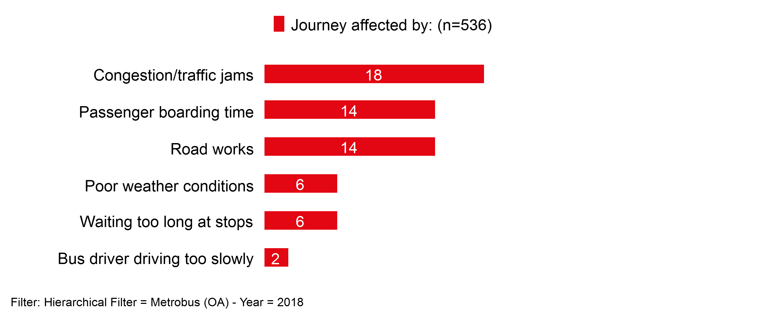
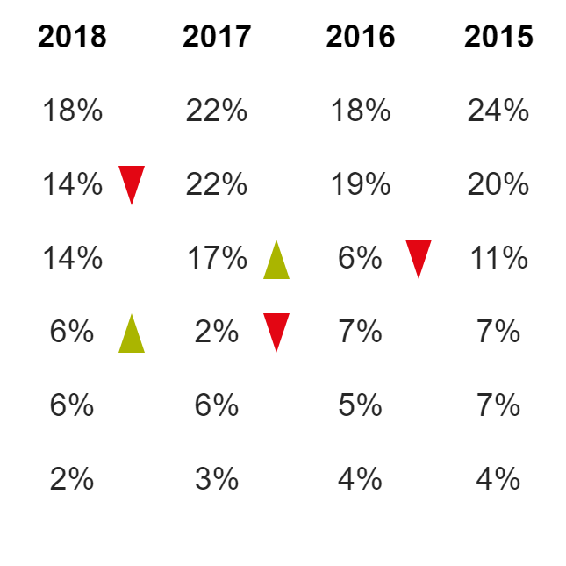
[Headline]
On the bus: journey time
Satisfaction with on-bus journey time
Total very and fairly satisfied
Q. How satisfied were you with the length of time your journey on the bus took?
Metrobus
Trend figures and Go-Ahead overall figs
What affected journey time?
Q. Was the length of time your journey took affected by any of the following? [note: multiple responses permitted]

Slide 6
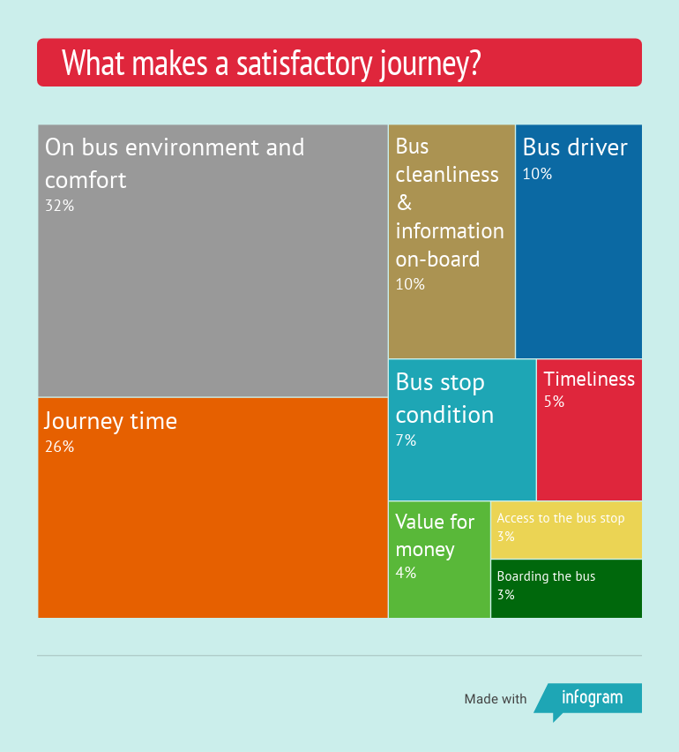
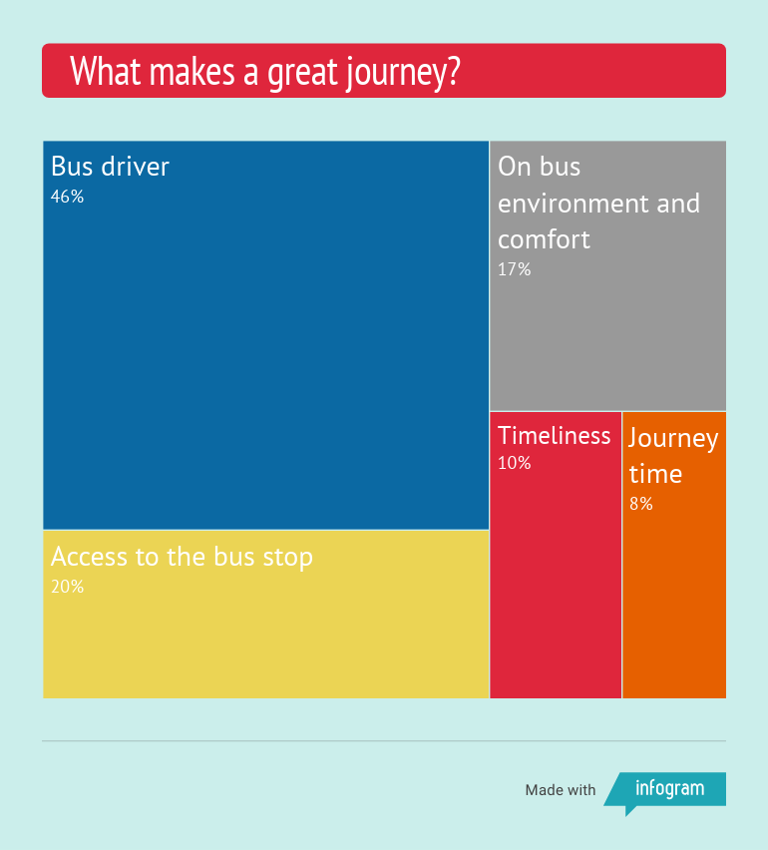
[Headline]
Overall experience: what makes a satisfactory or great bus journey?
Metrobus
Key Driver Analysis’ looks at fare paying passengers’ overall journey satisfaction response and their response to the 31 individual satisfaction measures in the survey (including value for money), which have been grouped into 10 themes based upon a statistical analysis of the responses.
The left hand chart shows which themes most differentiate between those not satisfied and satisfied overall – making a journey ‘satisfactory’.
The right hand chart shows which themes most differentiate between those fairly and very satisfied overall – making a ‘great’ journey.

Slide 7
Car/van drivers’ priorities for improvements to the SRN by region 2015
Nearly 5000 car and van drivers and motorcyclists ranked their priorities for improvement.
Improved quality of road surfaces are drivers’ top priority for improvement.
Safer design and maintenance of roads, better behaved drivers and the better management of roadworks also in top 4.
Notes:
Improvements to road surfaces were much more important to car and van drivers and motorbikers than these other priorities.

Slide 8
Strategic Roads User Survey (SRUS) Commenced April 2018
Purpose
To provide a reliable measure of user satisfaction, to be used by ORR to monitor Highways England’s performance against the target set for it by the government
To provide monthly insight which helps Highways England understand user experience and what it needs to do to improve it, with robust data generated for as many individual roads as possible
Who takes part?
8,000-9,000 road users every year
Drivers of cars, vans, lorries plus motorcyclists (not passengers in vehicles, not cyclists, pedestrians, equestrians etc.)
Includes 1,000 lorry drivers
Notes:
Measuring user satisfaction in the future
As part of its responsibilities the Watchdog will …. investigate how best to develop new surveys that provide a more accurate picture of road user needs and wants …
We expect that the new surveys will be developed for use during Road Period 1 and initially run in parallel with the NRUSS to ensure that the results are consistent.
The new surveys should be ready to replace the NRUSS by the start of Road Period 2 (20/21). They may be adopted earlier if the Watchdog, the Monitor, the Department and the Company feel it is sensible to do so.

Slide 9
SRUS – what is it telling us? Apr 2018
81%
Overall satisfaction
North East
North West
86%
75%
East
Midlands
78%
73%
M25
South West
84%
87%
South East
83%
% Very and fairly satisfied

Slide 10
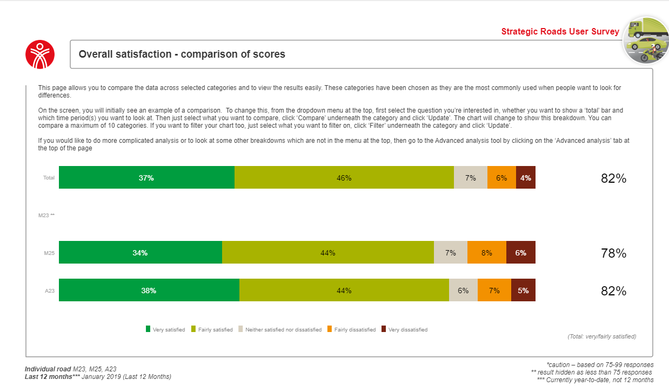
Overall Satisfaction – M25/M23/A23
Notes:
I have compared satisfaction scores for individual routes, not enough data for the M23, the A23 scored 82% and the M25 scored 78%.

Slide 11
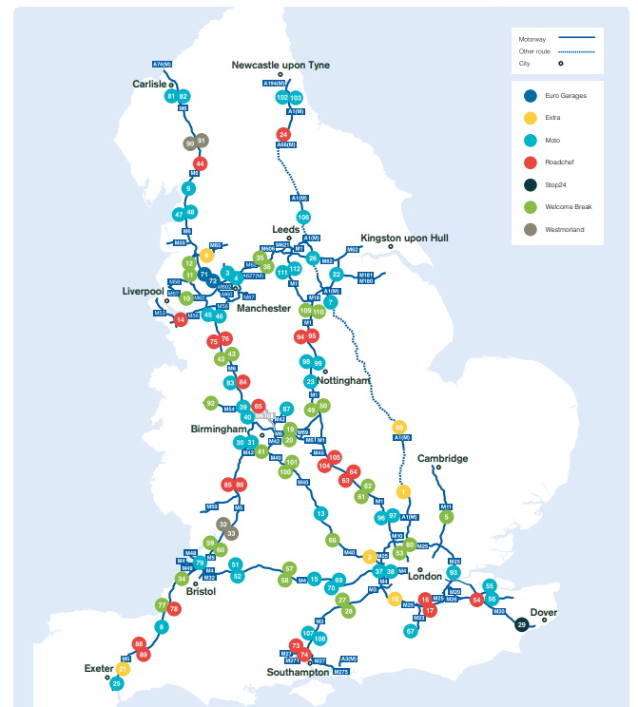
Motorway Services User Survey 2018 Overall satisfaction by motorway service area
Large – scale survey on the experience of 9600 visitors to 111 of England’s motorway service areas.
Visitor satisfaction remains very high
92 % said they were satisfied (up from 90 in previous year)
62 % said they were very satisfied with experience
Dissatisfaction remains extremely low – just 3%
Pease Pottage 99% satisfied
Clacket Lane 83% satisfied
Notes:
High levels of satisfaction in that a MSA offers the right environment for people to rest and recharge before continuing to drive, fulfilling basic, functional needs , food, toilets. Generally happy with he choice of food on offer, friendly staff, clean tables, quality of food and drink.

Slide 12
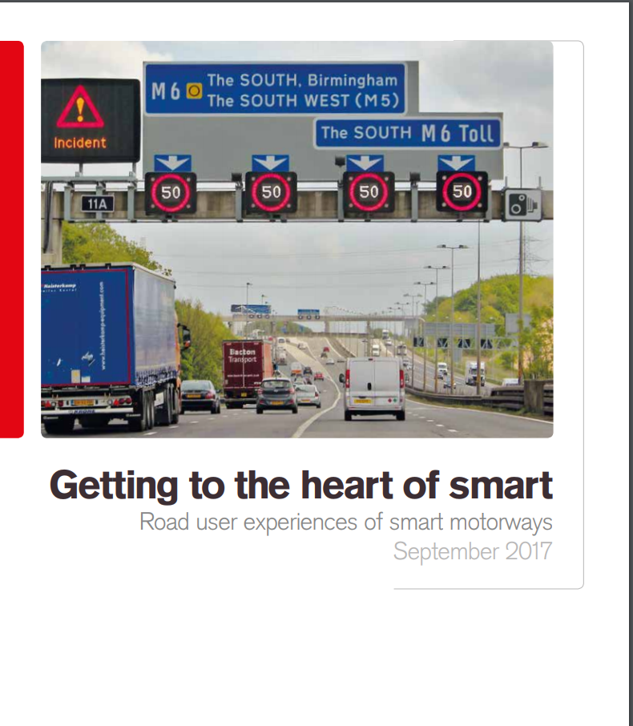
Getting to the heart of smart
Smart motorways’ are a key part of Highways England’s plans to deliver extra road capacity and more reliable journeys. Knowing what road users like and don’t like about them is therefore important.
The voice of the road user has often been absent in recent headlines, debates and inquiries.
This research looks to fill that gap, providing the views and experiences of those who use these roads.
M23 Junctions 8 to 10
The M23 - a crucial part of the UK SRN - connects Crawley and Gatwick Airport to M25, routes into London and the rest of the UK.
This stretch of the M23 is heavily used by traffic travelling to and from Gatwick Airport and between Brighton and London, especially during UK holiday periods.
Safety, congestion and journey times are key issues that need to be improved.
As junction 9 of the M23 is the main access for traffic travelling to and from Gatwick Airport, this scheme is of particular local and national economic and political importance.
Work commenced – going to 2021

Slide 13
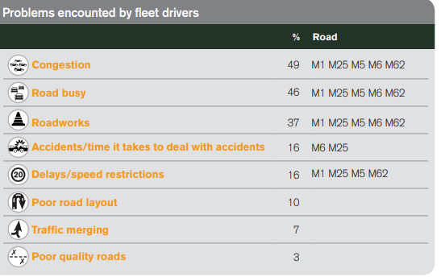
Road to the future? Route strategies
Identifying issues causing dissatisfaction
Three quarters of fleet managers say that drivers consistently highlight problems on Highways England’s roads to them.
This is mostly on motorways, with the M25 mentioned by 45%
Notes:
Problems encountered by fleet drivers on M25 are congestion 49%, busy road 46% , roadworks 37, accidents. 16%

Slide 14
Getting to and from the airport.
Is coach an option?
March 2019

Slide 15
Coach travel is often stigmatised
Non-users tend to see the coach as for…
Students
‘Young people’
‘Old people’
The coach is often seen as a mode of transport for the less affluent
Coaches are assumed to be an antisocial environment
Ultimately, many non-users’ start point about coach travel is that it is ‘not for me’
Some understanding - but typically very vague - that a coach network exists. But few have any clarity on how it works
Often assume only to/ from major cities
Almost no idea on times, frequencies, costs etc.
Do not know where/ how to access information, purchase tickets
Even those who live very close to coach stations are often unaware of their existence
Potential passengers are more likely to consider coach when they realise closeness to the network
I think it's just got a stigma on it for me. I don't know why. Maybe because they've plastered it pound sign, £1 to London, just seems too good to be true.
Newcastle, Coach User
Notes:
Many imagine they will experience some or all of the following:
Cramp
Boredom
Car sickness
Loud or crying children
Antisocial behaviour, drunk passengers
These negative perceptions about antisocial behaviour are worsened by the assumption that there will be no CCTV on board and that the driver will not be able to keep control

Slide 16
People want a stress-free surface access experience that is easy and convenient
Convenience
Speed
Past experience
Stress-free
At the airport
Cost

Slide 17
Majority have car/taxi available, but only a third believe coach is an option for the airport journey
76% were aware of at least one public transport option
46% travelling to London Airports are aware of coach as an option vs. only 24% travelling from non-London airports

Slide 18
Coach to the airport – starting from a low base
More likely to rate ease of getting to mode from home as important, 80% use car/taxi
Not aware of coach 63%
Aware of but don’t consider coach 26%
Less likely than coach users to rate low price as important and deterred by bad past experience, 40% already using other forms of public transport
Consider coach 6%
Use coach 4%
Younger, lower income. Low price most important factor

Slide 19
Challenges to overcome
Coach has a number of key challenges:
Low awareness
Poor match between strengths of coach
and key priorities of non-coach users
Low conversion rate
(proportion of those aware who use coach)
Frequency / hours of operation is an issue – the most important factor for passengers and hard to address for many coach traffic flows due to the volume of potential traffic
People travelling by coach are less satisfied with punctuality and flexibility in when they can travel – added stress that passengers do not want when travelling to an airport
Ability to use journey time constructively may provide an opportunity. It is not a key selection factor, but it is major dissatisfaction factor amongst car users

Slide 20
Priorities for encouraging more people to travel to the airport by coach
Work on and communicate progress in two key areas – punctuality and frequency / hours of operation
Continue to promote coach travel as a low cost option as this is the main driving factor for current use of coach
Look at and communicate (where possible) locality of pick up points to encourage people who are aware but not considering using coach to switch. Make it easy for people to get to the coach stops.
Awareness of coach needs to be raised outside of normal customer touchpoints, since many are not currently researching different modes.
Online is heavily used for researching and booking, can booking a coach be part of the flight booking process?

Slide 21
What rail passengers think…
National Rail Passenger Survey (NRPS)
Twice yearly, Spring/Autumn
60,000 respondents
Most recent - Autumn 2018, published January
Headlines: Overall Satisfaction- a ten year low.
Nationally – 79% (9% dissatisfied)
London and the South East – 78% (9% dissatisfied)
Commuters – 71%
Business – 80%
Leisure – 88%

Slide 22
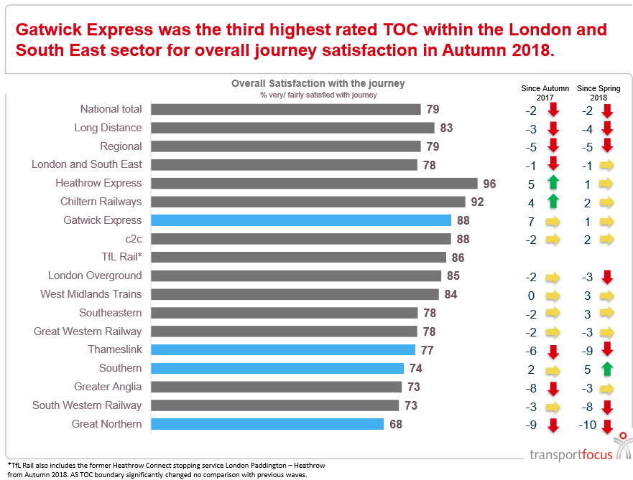

Slide 26
Rail Passengers’ Priorities for Improvement
Notes:
https://www.transportfocus.org.uk/research-publications/publications/rail-passengers-priorities-for-improvement/

Slide 27
Rail Passengers’ Priorities for Improvement
Notes:
http://d3cez36w5wymxj.cloudfront.net/wp-content/uploads/2017/11/27091738/Agency-slides-Rail-passengers-priorities-for-improvement-Nov-2017.pdf

Slide 28
Rail Passengers’ Priorities for Improvement at Stations

Slide 29
Franchising – the issues and the opportunity
Rail franchise competitions provide a major opportunity to seek improvements that benefit passengers
Contracts for periods of up to 15 years drive investment and set requirements for service provision
Historically, largely focussed on discussions between DfT and the industry
Competition between bidders previously came down to price
Consultations involved only ‘recognised’ stakeholders
In 2012 West Coast franchise award led to public outcry
Subsequent review of franchising created chance to press for new approach
Passenger interests and quality now embedded
Transport Focus has diverse role across many elements of process
Future of franchising now up for debate?

Slide 30
Williams Review
Review announced in September 2018
Led by Keith Williams, an independent chair, with an expert challenge panel
Looking at the commercial and organisational structure of the rail industry
Towards a White paper in Autumn 2019
Transport Focus input
Focus group research
Board Meeting in public
Evidence papers
Notes:
Keith: Deputy Chairman of John Lewis Partnership Former Chief Executive of British Airways

Slide 40
Next Steps…
Transport Focus Evidence papers published
What do passengers want?
What do passengers think about the structure of the railway
Two more papers to come
Non Users
Trust
Williams Reviews expected to report in July
White Paper in the Autumn

Slide 41
Fares Reform- Introduction
June 2018 - Easier Fares consultation, RDG and Transport Focus - to find out what the public want from ticketing and fares on the railway.
Consultation had 20,000 responses- summary was published in February 2018.
Next steps are working with government to review regulation and begin a series of real-world trials
Notes:
https://www.raildeliverygroup.com/media-centre/press-releases/2019/469762745-2019-02-18.html

Slide 42
Passengers’ views on rail fares and ticketing
Ask passengers what they think about fares and ticketing and you will hear:
Its expensive
There’s no logic in how fares are set
Its complicated and hard to find the right ticket
I’m never sure that I’ve got the right ticket
This erodes levels of trust
Have I paid more than I needed to?
Will someone tell me I have the wrong ticket and issue me with a penalty or make me buy a new ticket?
Many passengers do not think they get value for money:
46% satisfaction nationally
31% Commuters - 47% Business - 64% Leisure NRPS Autumn 2018

Slide 43
Fares concerns can deter use of rail
It creates a barrier to use:
The primary reasons non users give for not using trains more often are related to cost and inconvenience.
Perceptions matter: non users can over-estimate the cost of some journeys (views formed from the media and friends/family experiences)

Slide 44
What can be done to improve value for money?
Tailored products that match the way that many people are travelling now:
Flexible season tickets
Carnets
- Not paying for something I will not use could help to improve value
New ways of buying tickets (smart ticketing)
Fare increases
Move from RPI to CPI when calculating annual increases

Slide 45
What can be done to improve simplicity?
Single-leg pricing:
Mix-and-match menu approach (e.g. Advance out and off-peak back)
Better information about ticket restrictions and validities at the point of purchase.
Translating ‘industry-speak’ on routes and restrictions
Clarity and consistency over which tickets can be bought from what channel at what price
For example: why is Group Save not available from all channels?
Retail choice: buy how and when I want to buy

Slide 46
What can improve trust and consumer confidence?
Make it harder for me to buy the wrong ticket (e.g. Two Advance fares being more than an off-peak return)
What is the cheapest fare?
Split-ticketing is the elephant in the room when it comes to trust
Reducing the consequences of getting it wrong

Slide 47
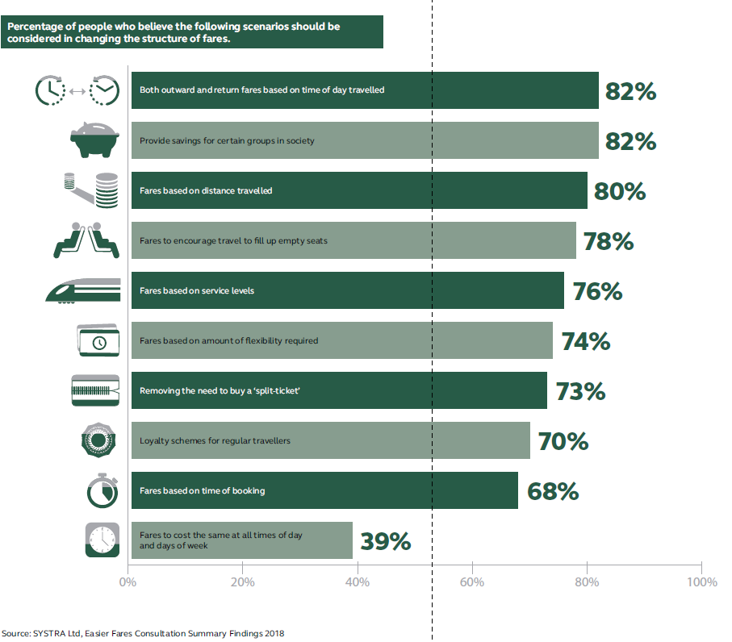
RDG fares reform- next steps
RDG consultation responses show…

Slide 48
Next Steps
These proposals will feed into the Williams review
Implementing a series of real-word trials and updating regulation to kick-start a rolling programme of reform across Britain over the next 3-5 years. Includes trials of:
Single leg pricing
- sale of tickets on a single leg basis so that people can mix and match the best value fares for the outward and return journeys
Pay as you go*
- on a suburban commuter operators coming into London, expanding flexible commuter fares beyond the capital
Leg-based pricing
where the price of a rail fare is calculated based on the additive price of the number of legs in the journey
* DfT also consulting on PAYG on rail - ends 1 May 2019
Notes:
Single Leg Pricing- LNER
Pay as you go-ie: c2c oyster cards
Leg based pricing - XC

Slide 49
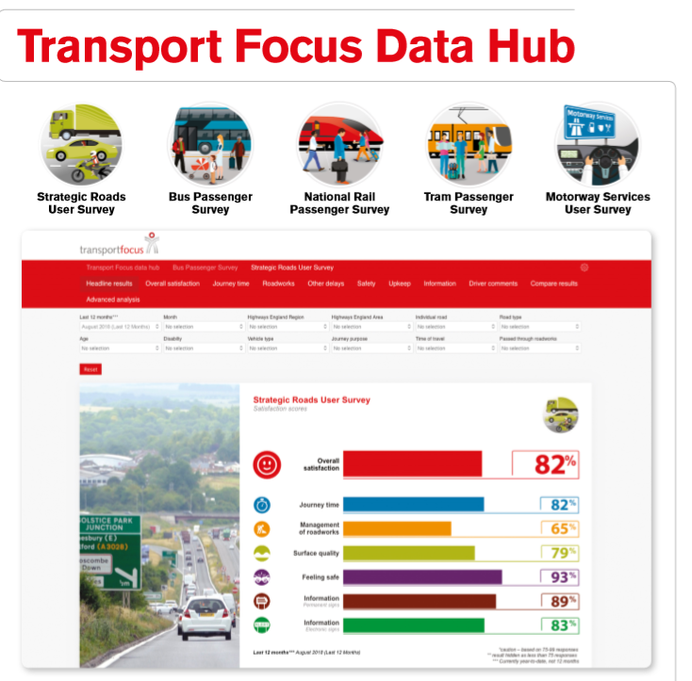
Transport Focus
www.transportfocus.org.uk
Sharon.hedges@transportfocus.org.uk
Linda.McCord@transportfocus.org.uk

