Slide 1
The Impact of Online on the Supply Chain CILT – Thames Valley Terry Murphy FCILT
10th February 2020

Slide 2
HATMILL SUPPLY CHAIN AND LOGISTICS ADVISORS
10th February, 2020

Slide 3
A proven track record of helping large blue chip and mid-sized businesses improve their supply chains
We have the right experience:
The development of optimised logistics strategies is core work to Hatmill and we have undertaken many similar engagements for clients in the UK, continental Europe and North America. These clients span the spectrum from small enterprises to some of the largest public corporations; mainly coming from the consumer goods, wholesale and retail sectors.
Why
We believe that all supply chains can be improved
How
We work in self-managed teams with clients to help them improve their customers’ experience
What
We improve their forecasting, their warehouses, their transport and their inventory

Slide 4
We work with a wide range of businesses improving their supply chains
4
CILT – Thames Valley

Slide 5
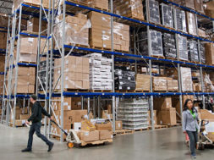
The John Lewis Supply Chain – pre-2010
Monday – Friday Shop Replenishment
Sunday – Thursday Customer Deliveries
Shops with >11 weeks’ Stock Cover
Planned, organised Peak build up
Nice and simple!!
Oh, for the old days!!!!

Slide 6
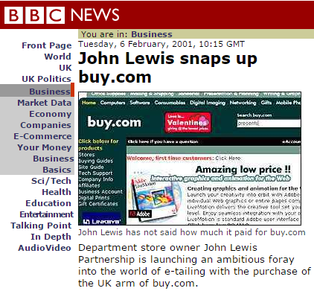

Slide 7
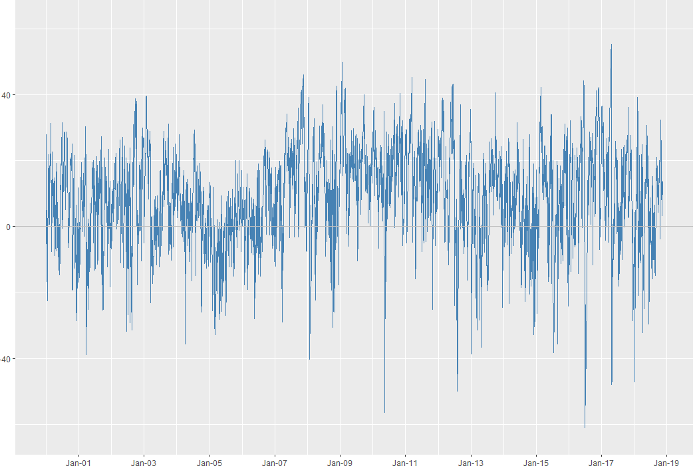
The Three Key Impacts
VOLUME
VOLATILITY
VELOCITY
Each of these ask questions of the
Supply Chain………..combined!!??

Slide 8
John Lewis – Share of Online Sales 2009 - 2019

Slide 9
Increasing pressures on Supply Chains
Ever Faster Delivery Times ….leading to
The Development of Urban Logistics….closer to the end Consumer….leading to
More expensive warehouse facilities…..leading to
Increased use of existing buildings and greater use of height…..leading to
Mezzanine floor development and
Increased use of Automation
All this AND the challenge of Sustainability

Slide 10
The Evolution of Warehousing…….
Distribution Centres
Automation, usually fixed
Automation, with Autonomous Mobile Robots
Fulfilment Centres, closer to demand
Urban Warehouses
Micro Fulfilment Centres

Slide 11
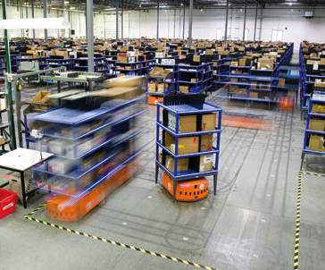
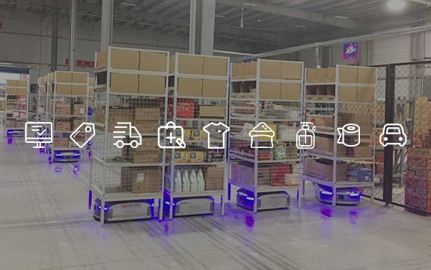
“Advanced Robotics”
Above, Kiva “robots”
Left, Geek “robots”

Slide 12
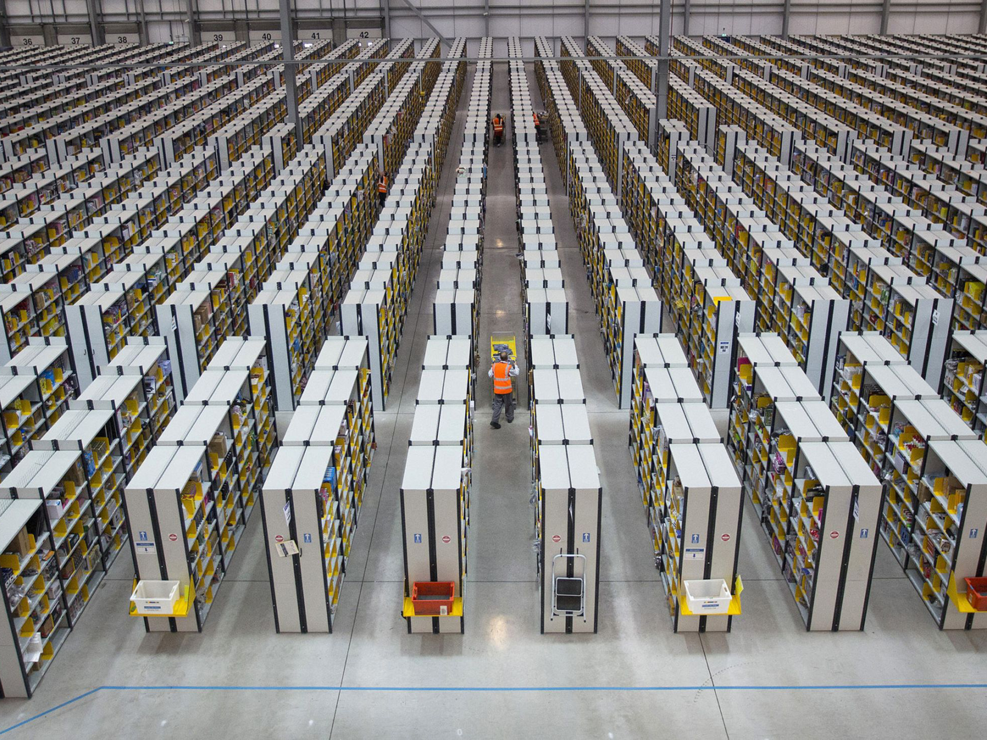
“Brace Yourself: Here Comes the Urban Mega-Warehouse”
Source – SupplyChainBrain, January, 2020

Slide 14
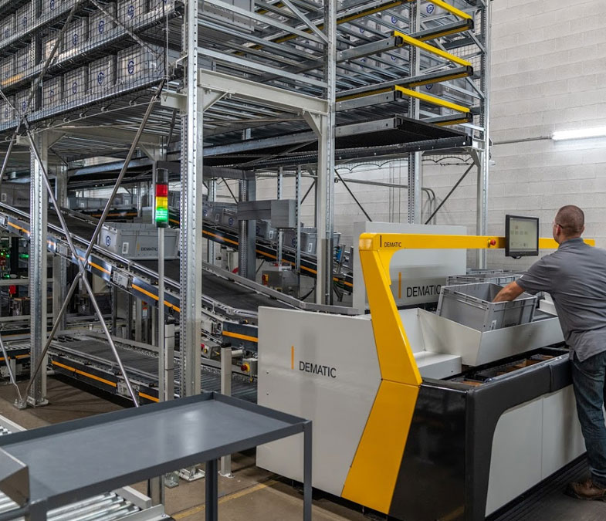
Dematic’s Micro Fulfilment Solution
Installation in as little as 12 weeks
Configuration into footprints as small as 10,000 sq. ft.
Industry standard-setting technology like the Dematic Multishuttle and Goods-to-Person picking solutions
Cold zone environment capabilities

Slide 15
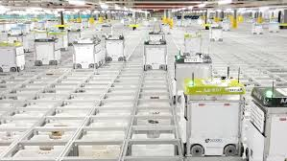
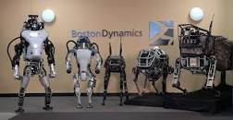
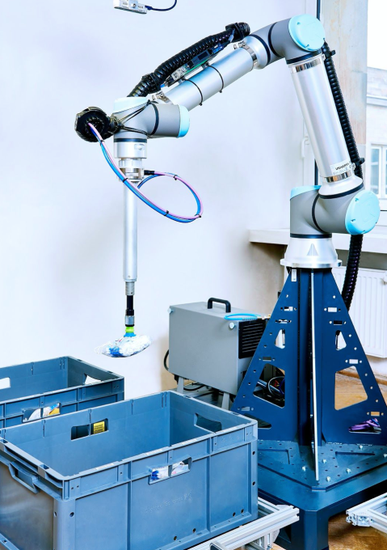
“Next Generation robotics”?
Left, Ocado’s Robot warehouses
Right, Boston Dynamics first team!

Slide 16
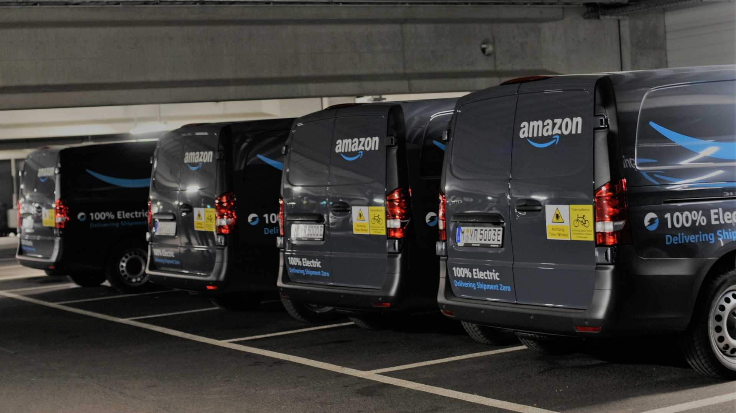
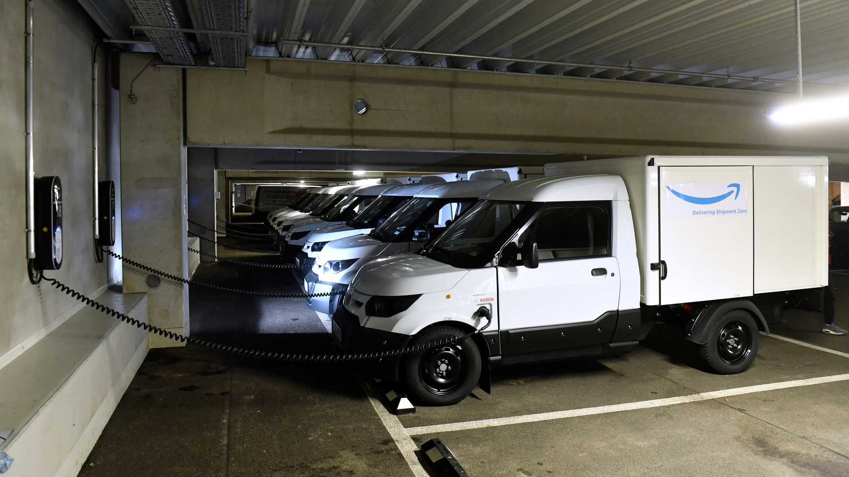
The Sustainability Challenge in Urban Logistics
Amazon, Germany – 10 Mercedes Benz E-vito and 40 StreetScooter WORK Box Vans
C60 Charging locations per Fulfilment Centre
Multi-level FCs, parking and charging on-site
Similar picture developing across the Amazon Estate

Slide 17
Summary
THREE KEY IMPACTS FROM ONLINE GROWTH
VOLUME
VOLATILITY
VELOCITY

Slide 18
ADDITIONAL CHALLENGES
RESOURCE AVAILABILITY
SUSTAINABILITY
RETURNS
THE PACE OF CHANGE

